Slide 1


Integrating Parsons Puzzle with MyUni
Project ID 27
Jialun Han
Neha Wali
Peiting Sun
Supervised by Dr. Cheryl Pope

Slide 2
Project Goals
Gather information, research and design a universal parsons puzzle to implement it for the subjects where algorithmic thinking is required.
Development of environment settings: Integrating H5P into Drupal and MyUni(canvas interface).
Implementation of two types of parsons puzzle: Drag and Drop, and Fill in the blanks as customised H5P function.

Slide 3
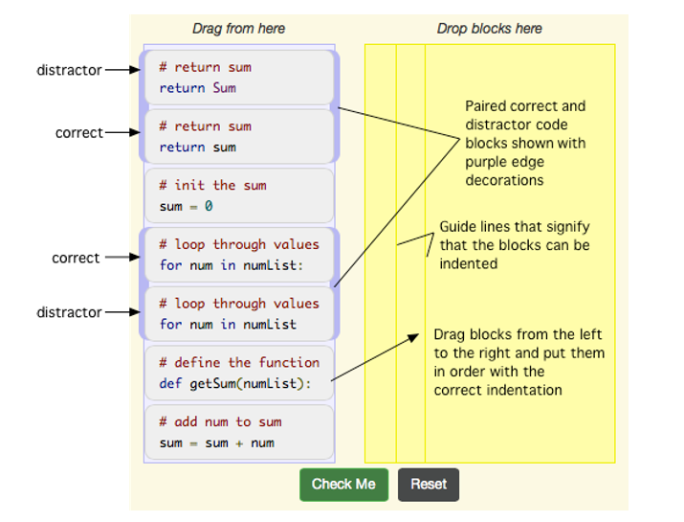
Goal 1: Universal Design Implemented
Parsons puzzle is designed to support learning of syntax and logic by teaching problem solving through algorithmic thinking and visualization.
Parsons puzzle is user interactive and engaging. It helps in implementing theory into practical implementation. It reduces time and effort of students to get deeper understanding
Integration is done to store the data of student attempts(track students progress)
Predefined syntax rule
Hints and Support
Expected Actions
Tag: difficulty level
Grades
Attempt History
Progress
Instructor interface components for creating a problem
Student interface components

Slide 4

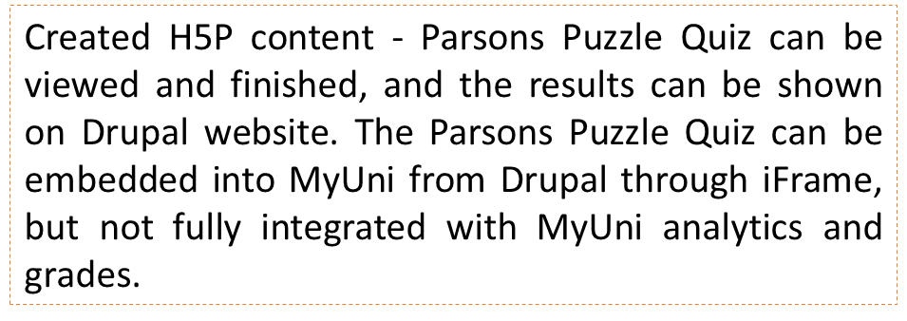



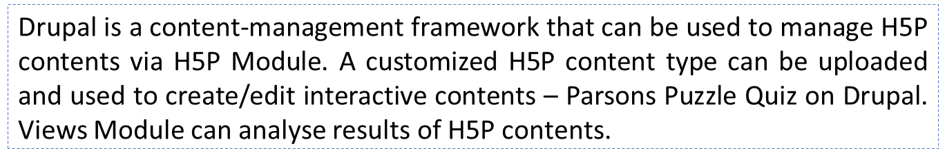





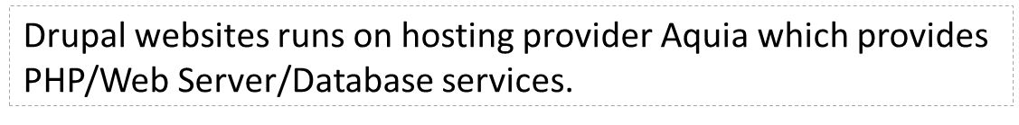

Goal 2: Software Architecture
User Interface
Drupal Site
MyUni - Canvas
Embedding
Parsons Puzzle Quiz – H5P
Parsons Puzzle Quiz
Grades
Views Module
H5P Module
Content-Manage Framework
PHP
Web Server
Database
– Hosting Provider

Slide 5
Goal 3: Demo

Slide 6

H5P structure
Customized H5P Content Type
parsons.js
(GitHub open source code )

Slide 7

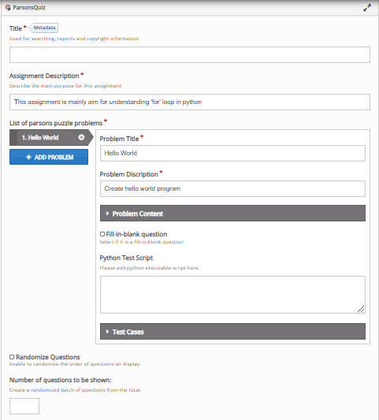

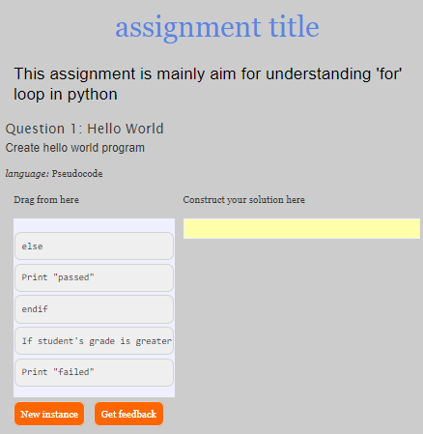
H5P structure
Metadata (library title , library description)
JS Libraries are used in parsons.js
lib
Parse instructor input
Initialize input value
h5peditor
CSS Libraries are used in parsons.js
semantics.json
library.json
style
H5p.js
(from Drupal h5p module)
Build parsons quiz h5p constructor and attach DOM to h5p container
Bring h5p container shown in page
H5P.ParsonsJS
H5P.jQuery
index.js
Contain the constructor of H5P parsonsquiz library
parsons.js
(GitHub open source code )
Parsons quiz web page

Slide 8
Future Extension
Data Collection and Analysis
Models can be built to analyse the data and generate data of topics which are hard to comprehend for students by taking into account their attempt time, number of attempts, actions an grades. Instructor can use this data to give extra support on the hard topics.
Data can be used to monitor student’s progression, to keep a check on their performance and to analyse how the parsons puzzle is helping the students to understand the complex topics better.
Models can be built to analyse the learning pattern of each student. Instructors can divide the students into different groups based on their different cognitive processing strategies, regulation strategies and learning motivations.

